Slide 1


Titolo presentazione sottotitolo
Temperature control in a four-rooms building
Milano, XX mese 20XX

Slide 2
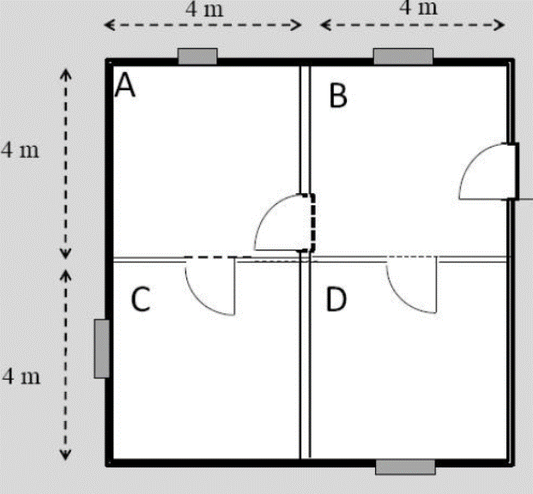
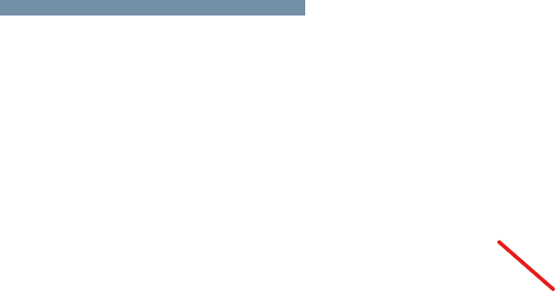
Problem Definition

Slide 3
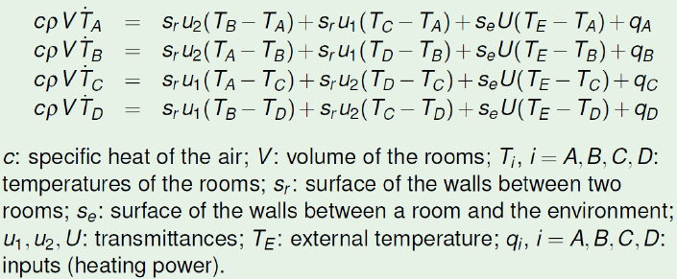
Mathematical model

Slide 4
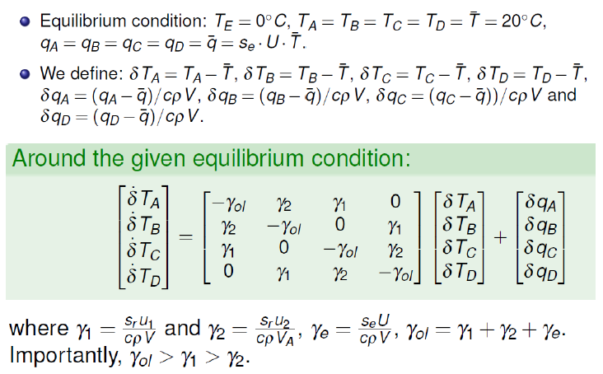
Linearization around the equilibrium point:

Slide 5
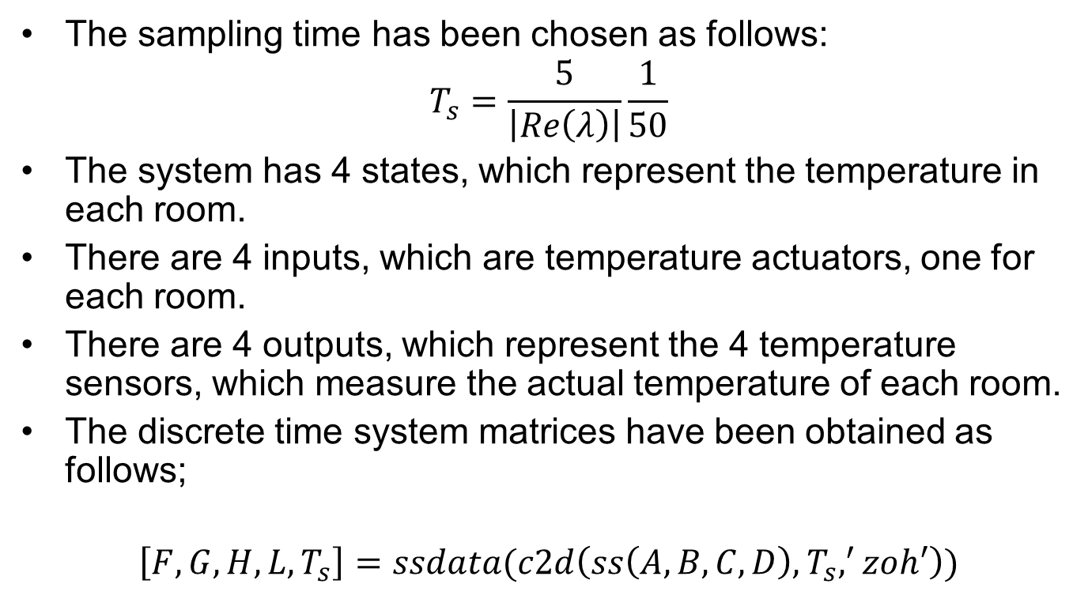
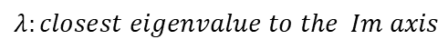
Description of the system and Design Choices
The sampling time has been chosen as follows:
$$T_{s}=\frac{5}{\left|Re\left(λ\right)\right|}\frac{1}{50}$$
The system has 4 states, which represent the temperature in each room.
There are 4 inputs, which are temperature actuators, one for each room.
There are 4 outputs, which represent the 4 temperature sensors, which measure the actual temperature of each room.
The discrete time system matrices have been obtained as follows;
$$\left[F,G,H,L,T_{s}\right]=ssdata(c2d\left(ss\left(A,B,C,D\right),T_{s},^{′}zoh′\right))$$
$$λ:closest eigenvalue to the Im axis$$

Slide 6
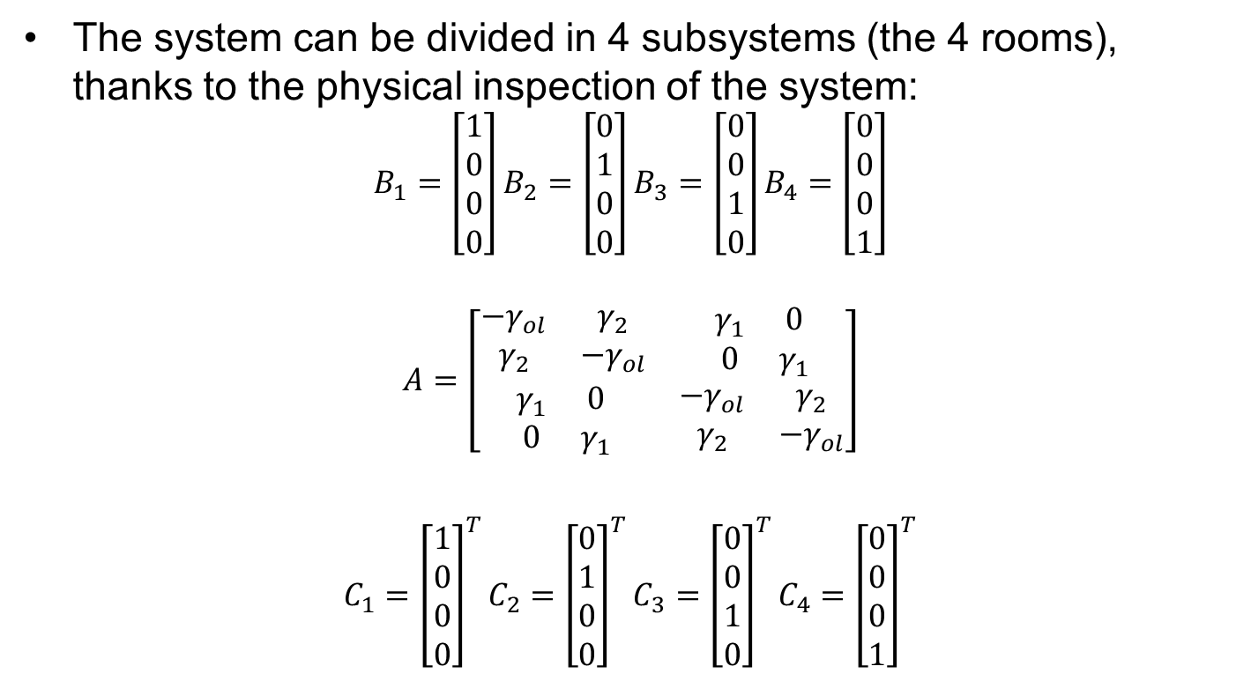
Division in Subsystems
The system can be divided in 4 subsystems (the 4 rooms), thanks to the physical inspection of the system:
$$B_{1}=\left[\begin{aligned}1 \\ 0 \\ 0 \\ 0\end{aligned}\right]B_{2}=\left[\begin{aligned}0 \\ 1 \\ 0 \\ 0\end{aligned}\right]B_{3}=\left[\begin{aligned}0 \\ 0 \\ 1 \\ 0\end{aligned}\right]B_{4}=\left[\begin{aligned}0 \\ 0 \\ 0 \\ 1\end{aligned}\right]$$
$$A=\left[\begin{matrix}\begin{matrix}{−γ}_{ol} & γ_{2} \\ γ_{2} & −γ_{ol}\end{matrix} & \begin{matrix}γ_{1} & 0 \\ 0 & γ_{1}\end{matrix} \\ \begin{matrix}γ_{1} & 0 \\ 0 & γ_{1}\end{matrix} & \begin{matrix}{−γ}_{ol} & γ_{2} \\ γ_{2} & {−γ}_{ol}\end{matrix}\end{matrix}\right]$$
$$C_{1}={\left[\begin{aligned}1 \\ 0 \\ 0 \\ 0\end{aligned}\right]}^{T}C_{2}={\left[\begin{aligned}0 \\ 1 \\ 0 \\ 0\end{aligned}\right]}^{T}C_{3}={\left[\begin{aligned}0 \\ 0 \\ 1 \\ 0\end{aligned}\right]}^{T}C_{4}={\left[\begin{aligned}0 \\ 0 \\ 0 \\ 1\end{aligned}\right]}^{T}$$

Slide 7
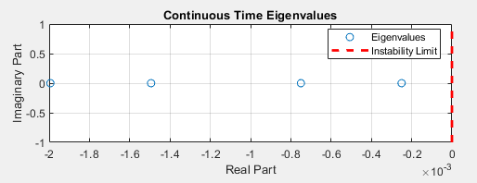
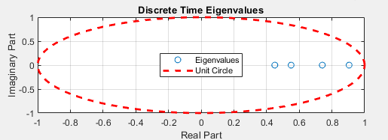
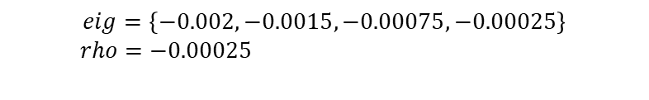

Open Loop Stability Analysis
The Open Loop System is
CONTINUOUS TIME
DISCRETE TIME
Approximately Simply Stable
Asymptotically Stable
$$eig=\left\{−0.002, −0.0015,−0.00075,−0.00025\right\}$$
$rho=−0.00025$
$$eig=\{0.9048, 0.7408,0.4504,0.5501\}$$
$rho=0.9048$

Slide 8
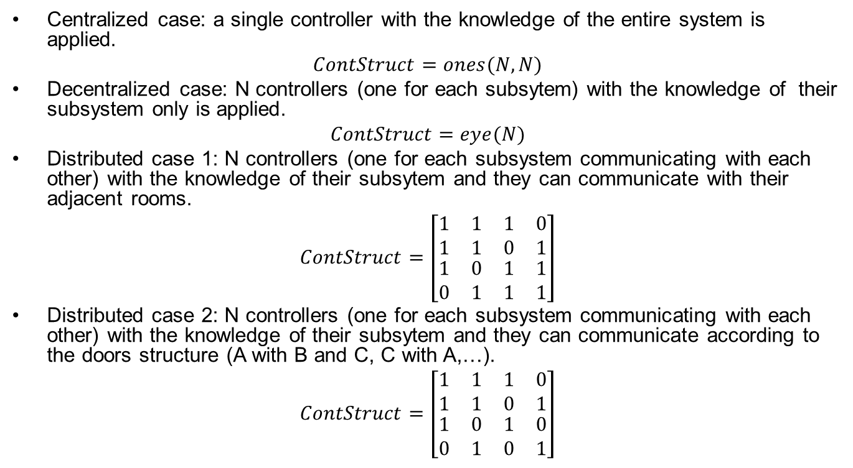
Control Architectures with State Feedback Control Laws
Centralized case: a single controller with the knowledge of the entire system is applied.
$$ContStruct=ones(N,N)$$
Decentralized case: N controllers (one for each subsytem) with the knowledge of their subsystem only is applied.
$$ContStruct=eye(N)$$
Distributed case 1: N controllers (one for each subsystem communicating with each other) with the knowledge of their subsytem and they can communicate with their adjacent rooms.
$$ContStruct=\left[\begin{matrix}\begin{matrix}1 & 1 \\ 1 & 1\end{matrix} & \begin{matrix}1 & 0 \\ 0 & 1\end{matrix} \\ \begin{matrix}1 & 0 \\ 0 & 1\end{matrix} & \begin{matrix}1 & 1 \\ 1 & 1\end{matrix}\end{matrix}\right]$$
Distributed case 2: N controllers (one for each subsystem communicating with each other) with the knowledge of their subsytem and they can communicate according to the doors structure (A with B and C, C with A,…).
$$ContStruct=\left[\begin{matrix}\begin{matrix}1 & 1 \\ 1 & 1\end{matrix} & \begin{matrix}1 & 0 \\ 0 & 1\end{matrix} \\ \begin{matrix}1 & 0 \\ 0 & 1\end{matrix} & \begin{matrix}1 & 0 \\ 0 & 1\end{matrix}\end{matrix}\right]$$

Slide 9
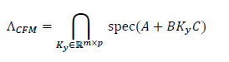
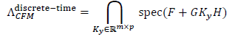
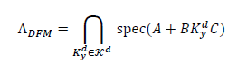
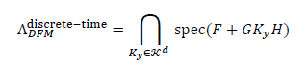
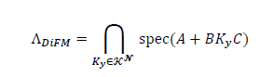
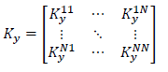
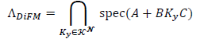
Definition of Fixed Modes
Centralized case (considering a static output feedback control law):
Decentralized case (considering a static output feedback control law):
Distributed case (considering a static output feedback control law):

Slide 10
Fixed Modes Analysis
In order to compute the fixed modes we have used the following function:
[Difm]=di_fixed_modes(A,B,C,N,ContStruc,rounding_n)
Where:
Difm: is the vector of all the fixed modes
A: is the state matrix
B: is the input matrix
C: is the output matrix
N: number of subsystems
ContStruc: is the matrix that defines which architecture is being used
rounding_n: digit that represents the decimal place at which the eigenvalues are rounded.
AFTER THE ANALYSIS WE NOTICED THAT THERE WERE NO FIXED MODES FOR ALL OUR ARCHITECTURES!

Slide 11
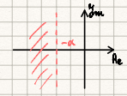
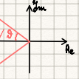
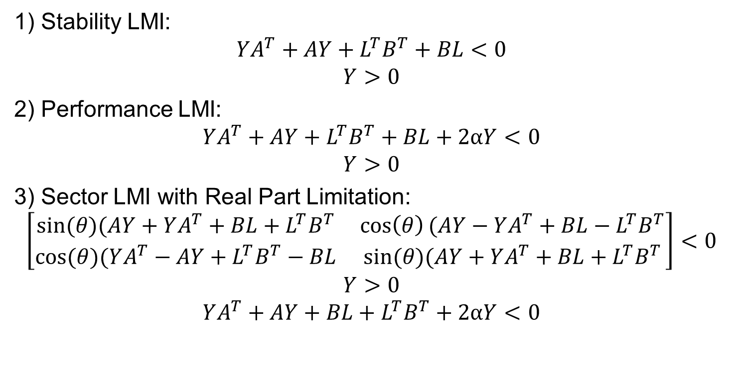
Application of LMIs in Continuous Time (Standard Cases)
1) Stability LMI:
$$YA^{T}+AY+L^{T}B^{T}+BL<0$$
$$Y>0$$
2) Performance LMI:
$$YA^{T}+AY+L^{T}B^{T}+BL+2αY<0$$
$$Y>0$$
3) Sector LMI with Real Part Limitation:
$$\left[\begin{matrix}sin⁡(θ)(AY+YA^{T}+BL+L^{T}B^{T} & \cos\left(θ\right)(AY−YA^{T}+BL−L^{T}B^{T} \\ cos⁡(θ)(YA^{T}−AY+L^{T}B^{T}−BL & sin⁡(θ)(AY+YA^{T}+BL+L^{T}B^{T}\end{matrix}\right]<0$$
$$Y>0$$
$$YA^{T}+AY+BL+L^{T}B^{T}+2αY<0$$

Slide 12
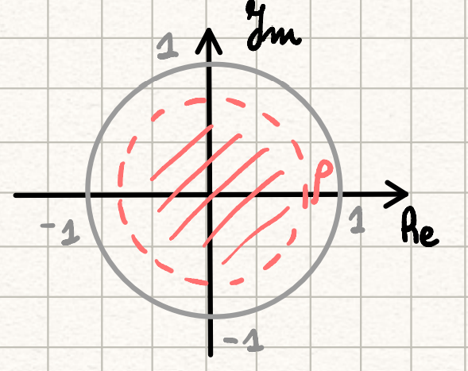
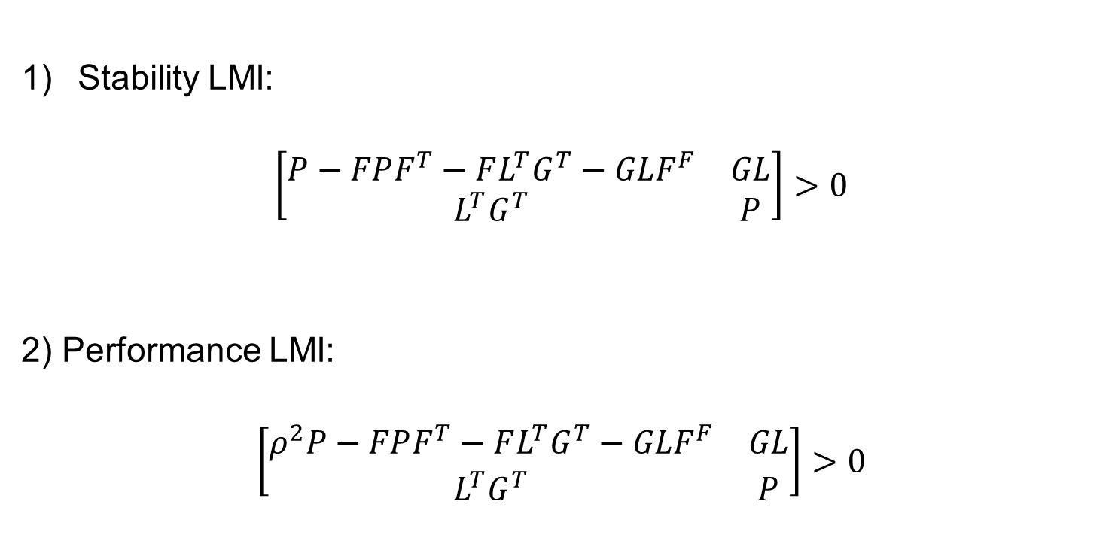
Application of LMIs in Discrete Time (Standard Cases)
Stability LMI:
$$\left[\begin{matrix}P−FPF^{T}−FL^{T}G^{T}−GLF^{F} & GL \\ L^{T}G^{T} & P\end{matrix}\right]>0$$
2) Performance LMI:
$$\left[\begin{matrix}ρ^{2}P−FPF^{T}−FL^{T}G^{T}−GLF^{F} & GL \\ L^{T}G^{T} & P\end{matrix}\right]>0$$

Slide 13
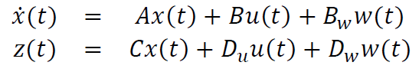
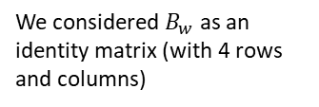
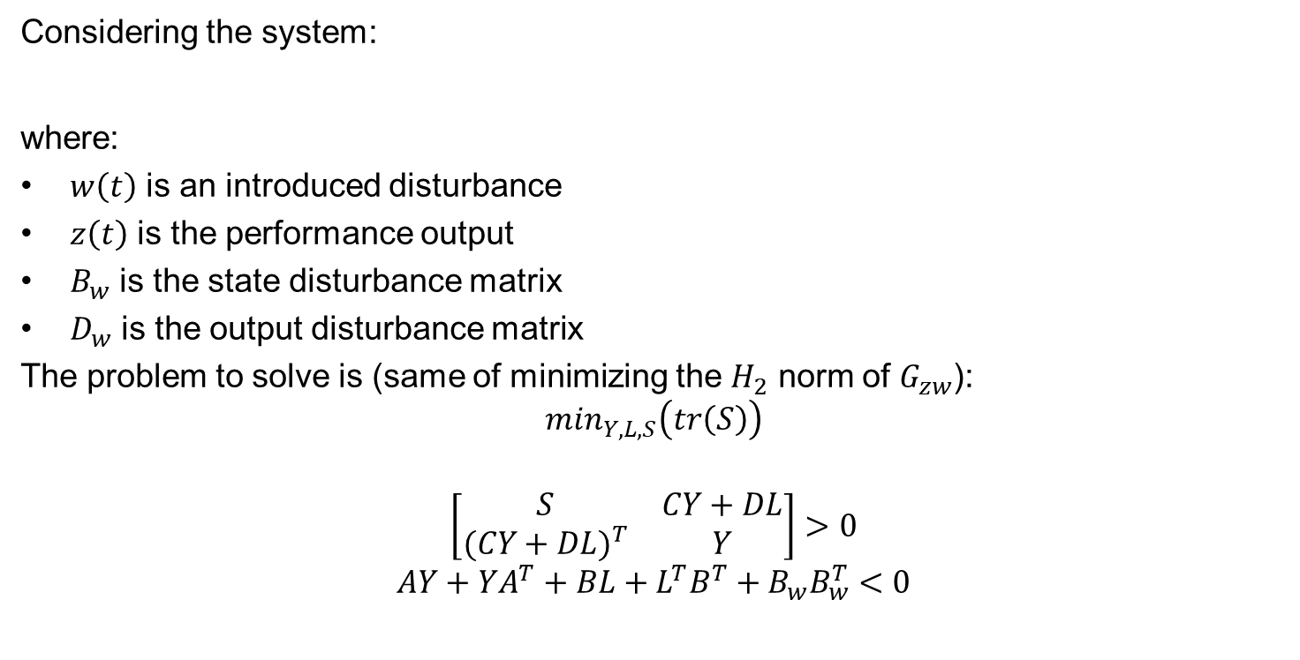
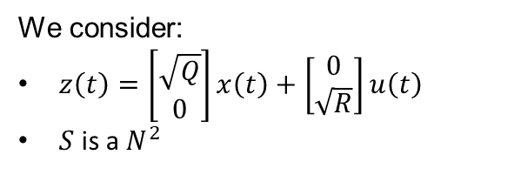
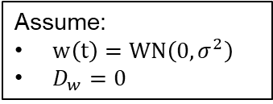
Application of LMIs in Continuous Time ($H_{2}$ minimization of $G_{zw}$)
Considering the system:
where:
$w\left(t\right)$ is an introduced disturbance
$z\left(t\right)$ is the performance output
$B_{w}$ is the state disturbance matrix
$D_{w}$ is the output disturbance matrix
The problem to solve is (same of minimizing the $H_{2}$ norm of $G_{zw}$):
$$\min_{Y,L,S}\left(tr\left(S\right)\right)$$
$$\left[\begin{matrix}S & CY+DL \\ {(CY+DL)}^{T} & Y\end{matrix}\right]>0$$
$$AY+YA^{T}+BL+L^{T}B^{T}+B_{w}B_{w}^{T}<0$$
Assume:
$w\left(t\right)=WN\left(0,σ^{2}\right)$
$D_{w}=0$
We consider:
$z\left(t\right)=\left[\begin{aligned}\sqrt{Q} \\ 0\end{aligned}\right]x\left(t\right)+$ $\left[\begin{aligned}0 \\ \sqrt{R}\end{aligned}\right]u\left(t\right)$
$S$ is a $N^{2}$
We considered $B_{w}$ as an identity matrix (with 4 rows and columns)

Slide 14
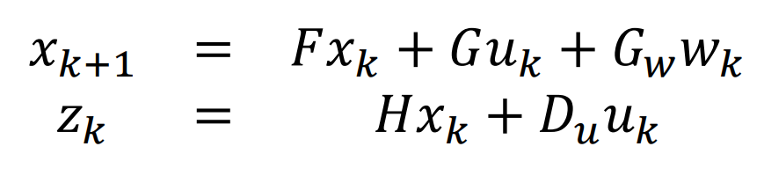
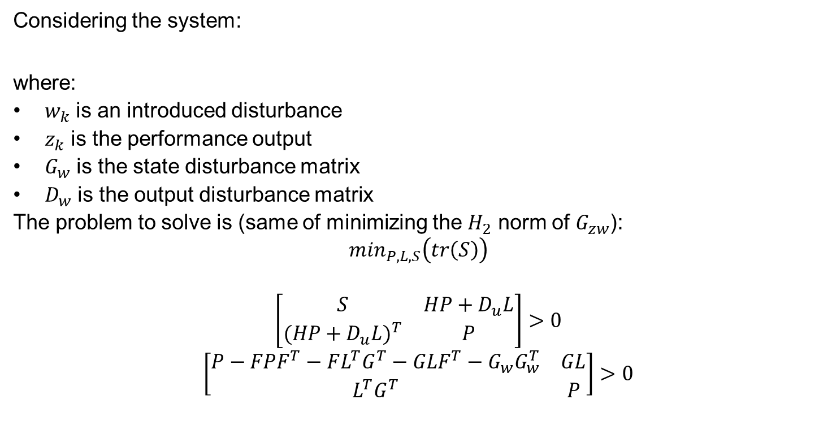
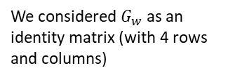
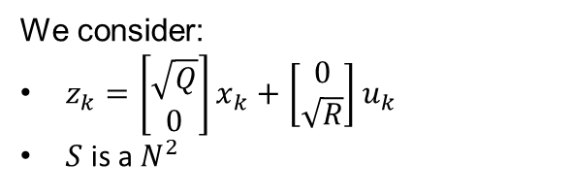
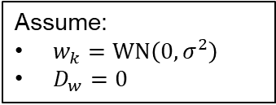
Application of LMIs in Discrete Time ($H_{2}$ minimization of $G_{zw}$)
Considering the system:
where:
$w_{k}$ is an introduced disturbance
$z_{k}$ is the performance output
$G_{w}$ is the state disturbance matrix
$D_{w}$ is the output disturbance matrix
The problem to solve is (same of minimizing the $H_{2}$ norm of $G_{zw}$):
$$\min_{P,L,S}\left(tr\left(S\right)\right)$$
$$\left[\begin{matrix}S & HP+D_{u}L \\ {(HP+D_{u}L)}^{T} & P\end{matrix}\right]>0$$
$$\left[\begin{matrix}P−FPF^{T}−FL^{T}G^{T}−GLF^{T}−G_{w}G_{w}^{T} & GL \\ L^{T}G^{T} & P\end{matrix}\right]>0$$
Assume:
$w_{k}=WN\left(0,σ^{2}\right)$
$D_{w}=0$
We consider:
$z_{k}=\left[\begin{aligned}\sqrt{Q} \\ 0\end{aligned}\right]x_{k}+$ $\left[\begin{aligned}0 \\ \sqrt{R}\end{aligned}\right]u_{k}$
$S$ is a $N^{2}$
We considered $G_{w}$ as an identity matrix (with 4 rows and columns)

Slide 15
Matlab Variables
We considered the following variables:
%% Variables definitions
Ts = 400 % Sampling time
N = 4 % Number of subsystems
alpha = 0.004 % -alpha defines the minimum acceptable Real part threshold for eigenvalues in the performance LMI case (Continuous time)
rho = pi/4 % Defines the maximum acceptable radius for the largest circonference that contains the eigenvalues in the performance LMI case (Discrete time)
qc = 0.005 % Value that defines the Q matrix in the H2 minimization LMI (Continuous Time)
rc = 1000 % Value that defines the R matrix in the H2 minimization LMI (Continuous Time)
qd = 0.005 % Value that defines the Q matrix in the H2 minimization LMI (Discrete Time)
rd = 100 % Value that defines the R matrix in the H2 minimization LMI (Discrete Time)
theta_s = pi/4 % Angle defining the sector angle
x0 = [2; 1; -1; 0.7;] % Initial states

Slide 16
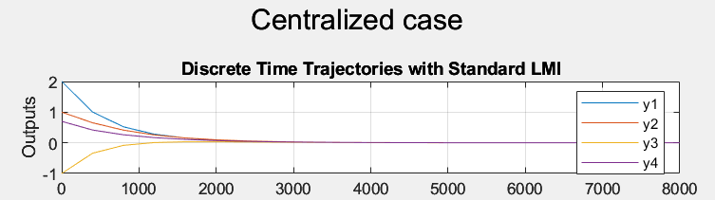
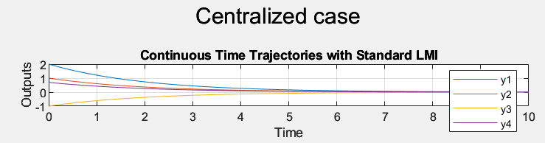
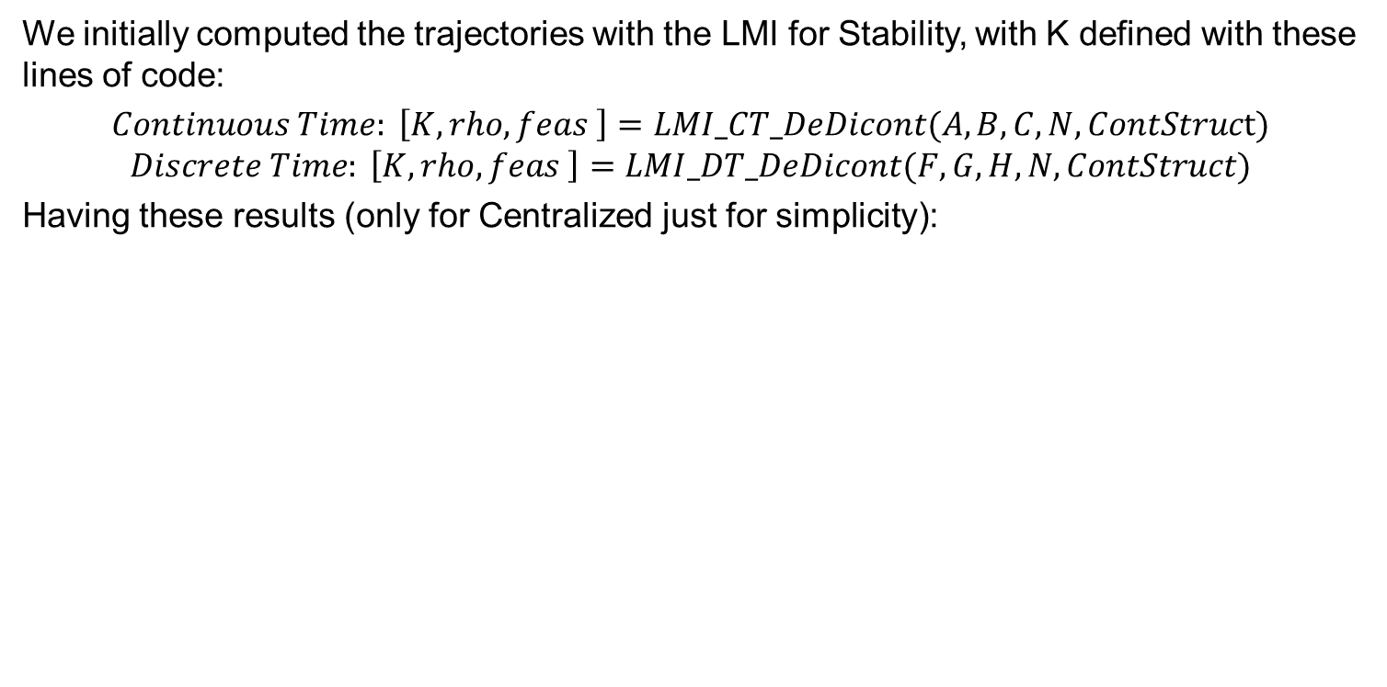
Continuous time Control effort 1
We initially computed the trajectories with the LMI for Stability, with K defined with these lines of code:
$Continuous Time: \left[K, rho, feas \right]=LMI_CT_DeDicont(A,B,C,N,ContStruct)$
$$Discrete Time: \left[K, rho, feas \right]=LMI_DT_DeDicont(F,G,H,N,ContStruct)$$
Having these results (only for Centralized just for simplicity):

Slide 17
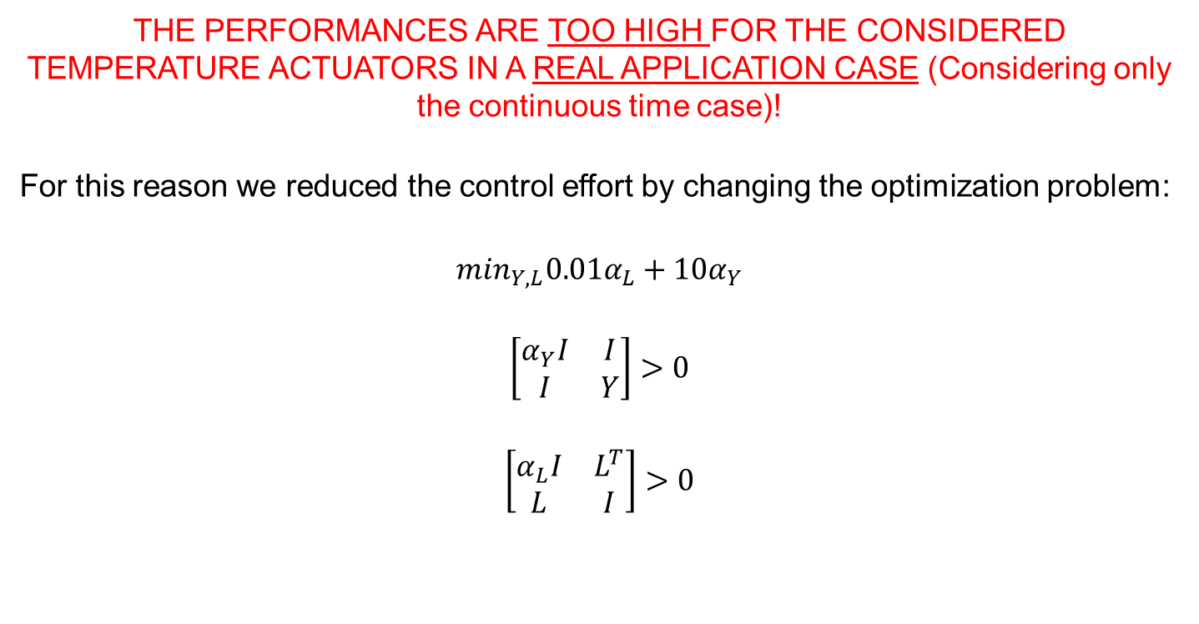
Continuous time Control effort 2
THE PERFORMANCES ARE TOO HIGH FOR THE CONSIDERED TEMPERATURE ACTUATORS IN A REAL APPLICATION CASE (Considering only the continuous time case)!
For this reason we reduced the control effort by changing the optimization problem:
$$\min_{Y,L}{0.01α}_{L}+{10α}_{Y}$$
$$\left[\begin{matrix}α_{Y}I & I \\ I & Y\end{matrix}\right]>0$$
$$\left[\begin{matrix}α_{L}I & L^{T} \\ L & I\end{matrix}\right]>0$$
Then it is needed to add the constraints related to the chosen LMI

Slide 18
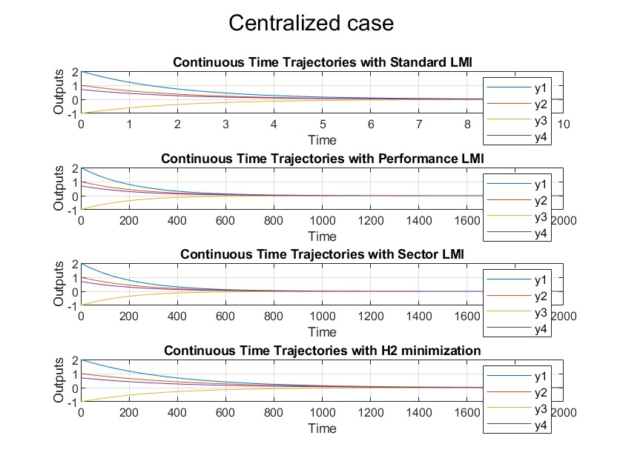
Centralized control Trajectories (Continuous time)
[K_cc,rho_cc,feas_cc] = LMI_CT_DeDicont(A,B_comp,C_comp,N,ContStruc_c);
[K_cc_a, rho_cc_a, feas_cc_a] = LMI_CT_DeDicont_perf_alpha(A,B_comp,C_comp,N,ContStruc_c,alpha);
[K_cc_s, rho_cc_s, feas_cc_s] = LMI_CT_DeDicont_sector(A,B_comp,C_comp,N,ContStruc_c,theta_s);
[K_cc_h2, rho_cc_h2, feas_cc_h2] = LMI_CT_DeDicont_H2(A,B_comp,C_comp,N,ContStruc_c,qc,rc);

Slide 19
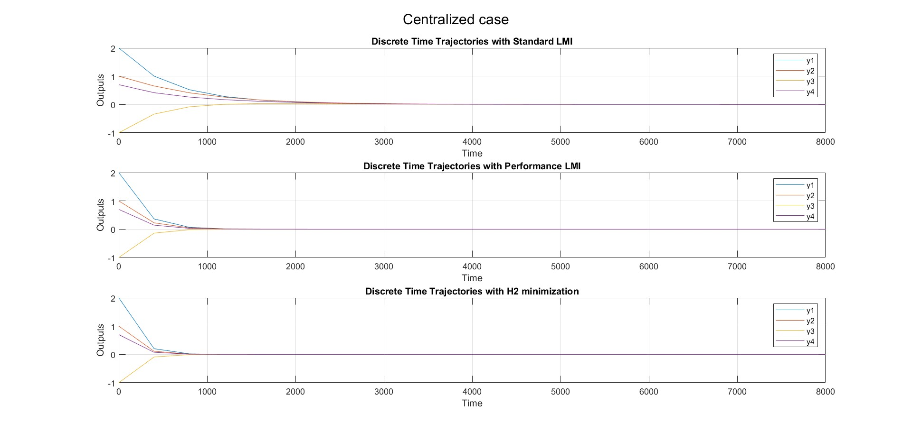
Centralized control Trajectories (Discrete time)
[K_dc,rho_dc,feas_dc] = LMI_DT_DeDicont(F,G_comp,H_comp,N,ContStruc_c);
[K_dc_p, rho_dc_p, feas_dc_p] = LMI_DT_DeDicont_perf_p(F,G_comp,H_comp,N,ContStruc_c,0.5);
[K_dc_h2, rho_dc_h2, feas_dc_h2] = LMI_DT_DeDicont_H2(F,G_comp,H_comp,N,ContStruc_c,qd,rd);

Slide 20
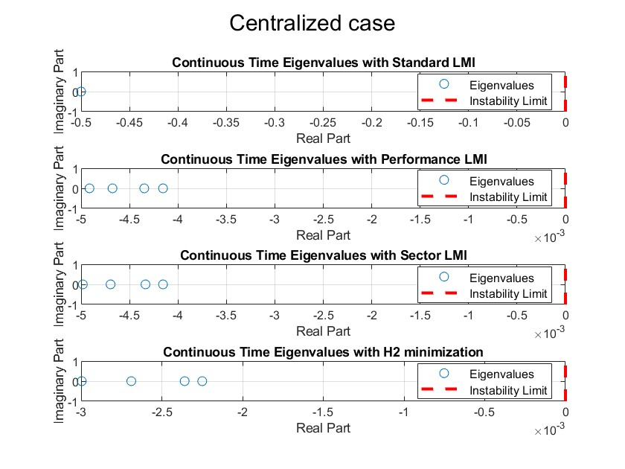
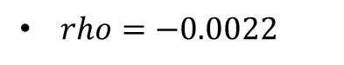
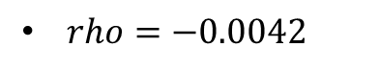
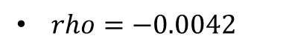
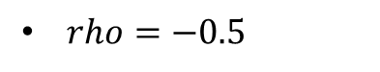
Centralized control Eigenvalues (Continuous time)
$rho=−0.5$
$rho=−0.0042$
$rho=−0.0042$
$rho=−0.0022$
ALL THE LMI PROBLEMS ARE FEASIBLE!

Slide 21
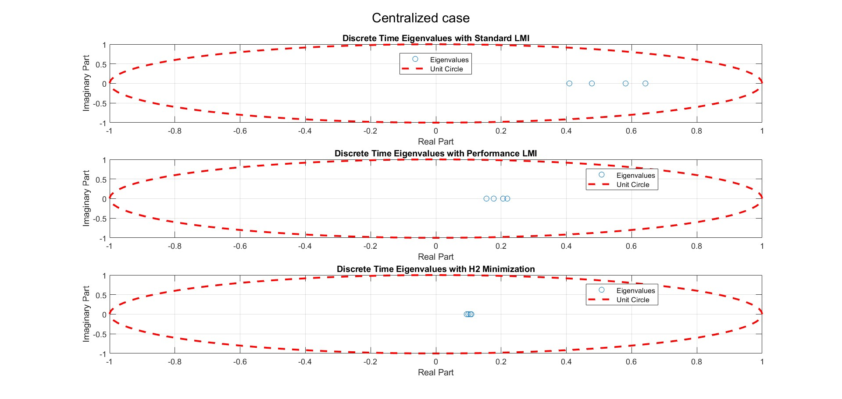
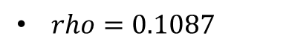
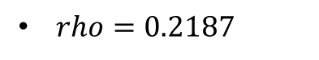
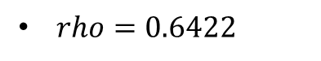
Centralized control Eigenvalues (Discrete time)
$rho=0.6422$
$rho=0.2187$
$rho=0.1087$
ALL THE LMI PROBLEMS ARE FEASIBLE!

Slide 22
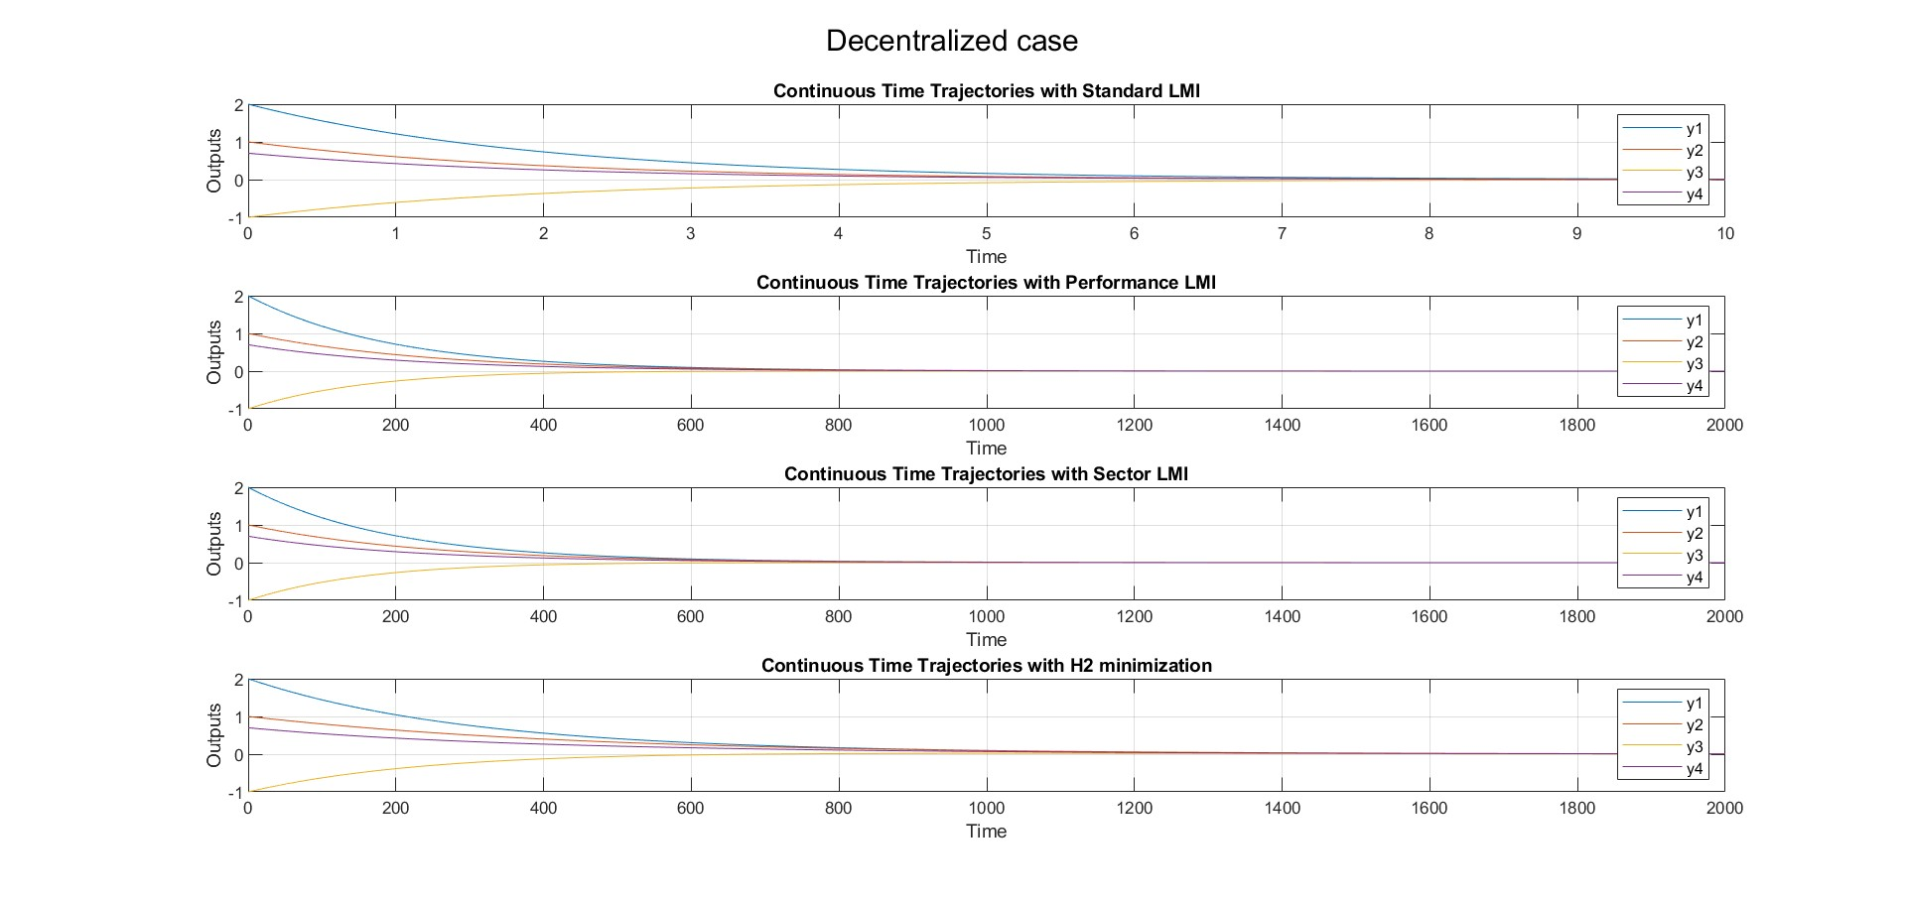
Decentralized control Trajectories (Continuous time)
[K_cde,rho_cde,feas_cde] = LMI_CT_DeDicont(A,B_comp,C_comp,N,ContStruc_de);
[K_cde_a, rho_cde_a, feas_cde_a] = LMI_CT_DeDicont_perf_alpha(A,B_comp,C_comp,N,ContStruc_de,alpha);
[K_cde_s, rho_cde_s, feas_cde_s] = LMI_CT_DeDicont_sector(A,B_comp,C_comp,N,ContStruc_de,theta_s);
[K_cde_h2, rho_cde_h2, feas_cde_h2] = LMI_CT_DeDicont_H2(A,B_comp,C_comp,N,ContStruc_de,qc,rc);

Slide 23
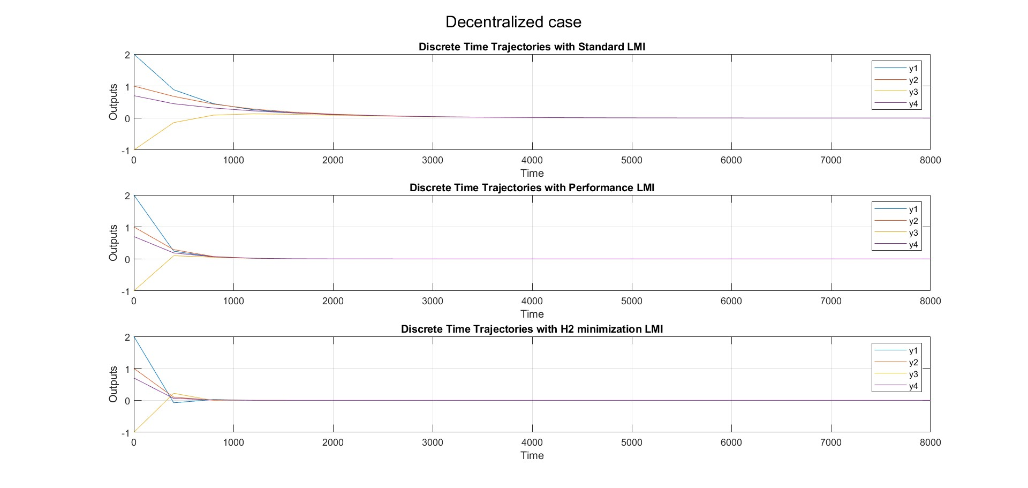
Decentralized control Trajectories (Discrete time)
[K_dde,rho_dde,feas_dde] = LMI_DT_DeDicont(F,G_comp,H_comp,N,ContStruc_de);
[K_dde_p, rho_dde_p, feas_dde_p] = LMI_DT_DeDicont_perf_p(F,G_comp,H_comp,N,ContStruc_de,0.5);
[K_dde_h2, rho_dde_h2, feas_dde_h2] = LMI_DT_DeDicont_H2(F,G_comp,H_comp,N,ContStruc_de,qd,rd);

Slide 24





Decentralized control Eigenvalues (Continuous time)
$rho=−0.4991$
$rho=−0.0042$
$rho=−0.0042$
$rho=−0.0022$
ALL THE LMI PROBLEMS ARE FEASIBLE!

Slide 25




Decentralized control Eigenvalues (Discrete time)
$rho=0.6913$
$rho=0.3035$
$rho=0.1240$
ALL THE LMI PROBLEMS ARE FEASIBLE!

Slide 26

Distributed 1 control Trajectories (Continuous time)
[K_cdi_1,rho_cdi_1,feas_cdi_1] = LMI_CT_DeDicont(A,B_comp,C_comp,N,ContStruc_di_1);
[K_cdi_1_a, rho_cdi_1_a, feas_cdi_1_a] = LMI_CT_DeDicont_perf_alpha(A,B_comp,C_comp,N,ContStruc_di_1,alpha);
[K_cdi_1_s, rho_cdi_1_s, feas_cdi_1_s] = LMI_CT_DeDicont_sector(A,B_comp,C_comp,N,ContStruc_di_1,theta_s);
[K_cdi_1_h2, rho_cdi_1_h2, feas_cdi_1_h2] = LMI_CT_DeDicont_H2(A,B_comp,C_comp,N,ContStruc_di_1,qc,rc);

Slide 27

Distributed 1 control Trajectories (Discrete time)
[K_ddi_1,rho_ddi_1,feas_ddi_1] = LMI_DT_DeDicont(F,G_comp,H_comp,N,ContStruc_ddi_1);
[K_ddi_1_p, rho_ddi_1_p, feas_ddi_1_p] = LMI_DT_DeDicont_perf_p(F,G_comp,H_comp,N,ContStruc_ddi_1,0.5);
[K_ddi_1_h2, rho_ddi_1_h2, feas_ddi_1_h2] = LMI_DT_DeDicont_H2(F,G_comp,H_comp,N,ContStruc_ddi_1,qd,rd);

Slide 28





Distributed 1 control Eigenvalues (Continuous time)
$rho=−0.5$
$rho=−0.0042$
$rho=−0.0042$
$rho=−0.0026$
ALL THE LMI PROBLEMS ARE FEASIBLE!

Slide 29




Distributed 1 control Eigenvalues (Discrete time)
$rho=0.6337$
$rho=0.2435$
$rho=0.1171$
ALL THE LMI PROBLEMS ARE FEASIBLE!

Slide 30

Distributed 2 control Trajectories (Continuous time)
[K_cdi_2,rho_cdi_2,feas_cdi_2] = LMI_CT_DeDicont(A,B_comp,C_comp,N,ContStruc_di_2);
[K_cdi_2_a, rho_cdi_2_a, feas_cdi_2_a] = LMI_CT_DeDicont_perf_alpha(A,B_comp,C_comp,N,ContStruc_di_2,alpha);
[K_cdi_2_s, rho_cdi_2_s, feas_cdi_2_s] = LMI_CT_DeDicont_sector(A,B_comp,C_comp,N,ContStruc_di_2,theta_s);
[K_cdi_2_h2, rho_cdi_2_h2, feas_cdi_2_h2] = LMI_CT_DeDicont_H2(A,B_comp,C_comp,N,ContStruc_di_2,qc,rc);

Slide 31

Distributed 2 control Trajectories (Discrete time)
[K_ddi_2,rho_ddi_2,feas_ddi_2] = LMI_DT_DeDicont(F,G_comp,H_comp,N,ContStruc_ddi_2);
[K_ddi_2_p, rho_ddi_2_p, feas_ddi_2_p] = LMI_DT_DeDicont_perf_p(F,G_comp,H_comp,N,ContStruc_ddi_2,0.5);
[K_ddi_2_h2, rho_ddi_2_h2, feas_ddi_2_h2] = LMI_DT_DeDicont_H2(F,G_comp,H_comp,N,ContStruc_ddi_2,qd,rd);

Slide 32




Distributed 2 control Eigenvalues (Continuous time)
$rho=−0.4998$
$rho=−0.0042$
$rho=−0.0042$
$rho=−0.0025$
ALL THE LMI PROBLEMS ARE FEASIBLE!

Slide 33




Distributed 2 control Eigenvalues (Discrete time)
$rho=0.6470$
$rho=0.2579$
$rho=0.1152$
ALL THE LMI PROBLEMS ARE FEASIBLE!

Slide 34
Comments on the Results
Conclusions:
Low coupling between the rooms
Real applicability of the solutions
Architecture and Control choices

Slide 35





Low Coupling between the Rooms
Conclusions:
Distributed (Case 2):
$$rho=−0.0025$$
Distributed (Case 3):
[coupling between opposite rooms]
$$rho=−0.0026$$
SAME FOR DISCRETE TIME!
Distributed (Case 2):
$$rho=0.1152$$
Distributed (Case 3):
$$rho=0.1240$$

Slide 36


Real applicability of the Solution
Conclusions:
$$Worst case Power≈1000W$$
$$Average AC Power=1500÷2600W$$
$$Ground Fault Circuit Interrupter Power≈1500÷6000W$$

Slide 37
THANKS TO EVERYONE FOR YOUR ATTENTION

